Slide 1
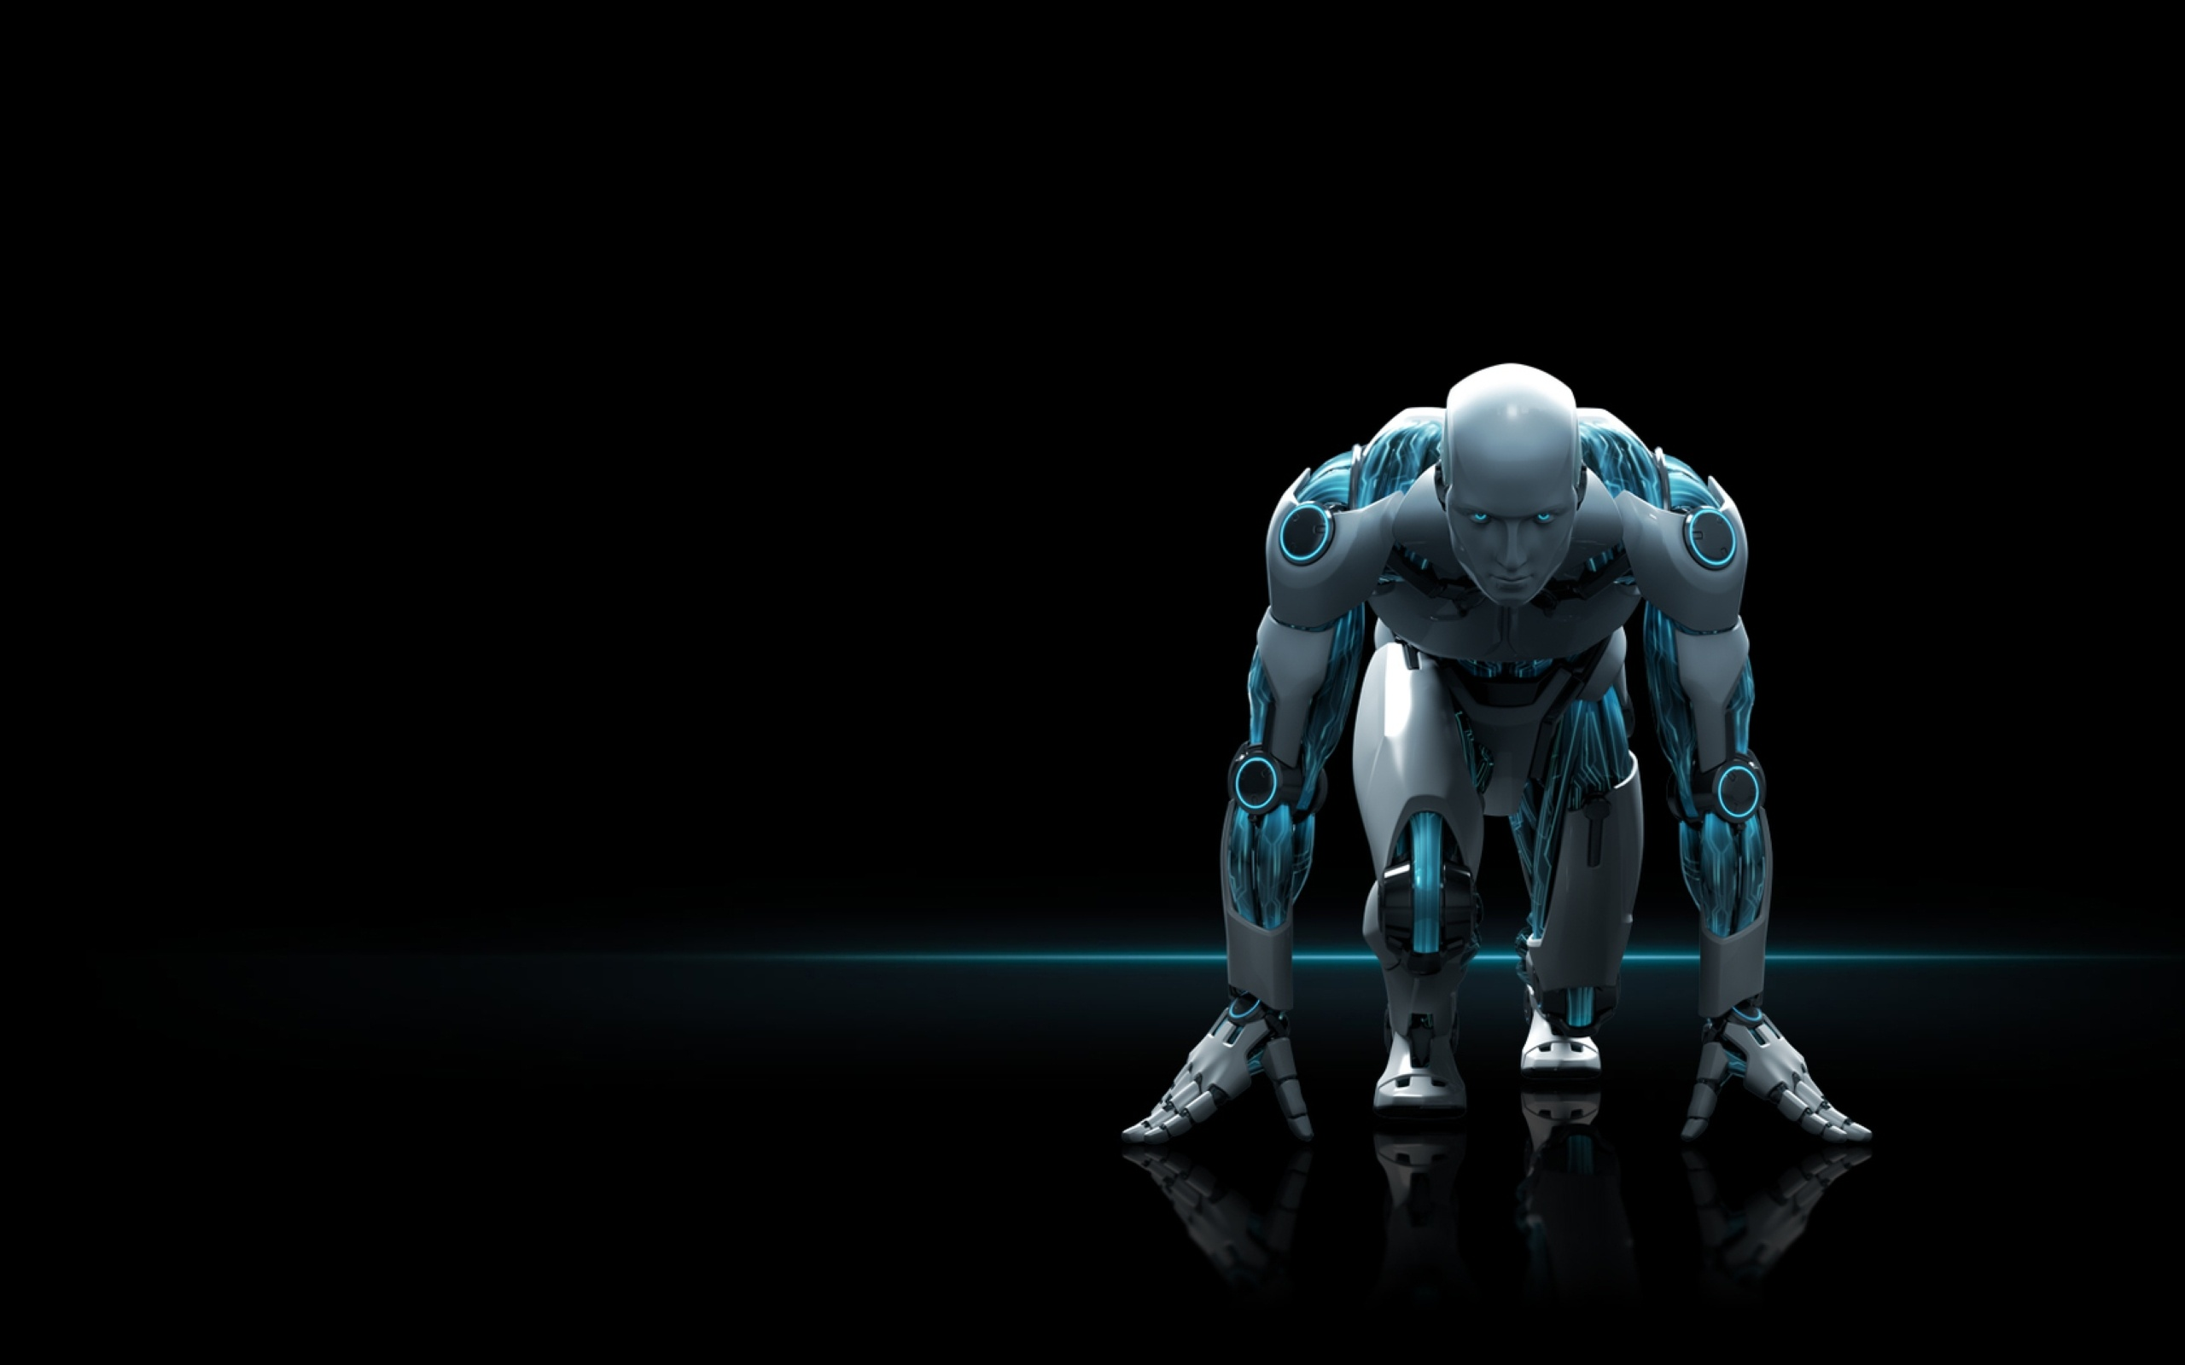
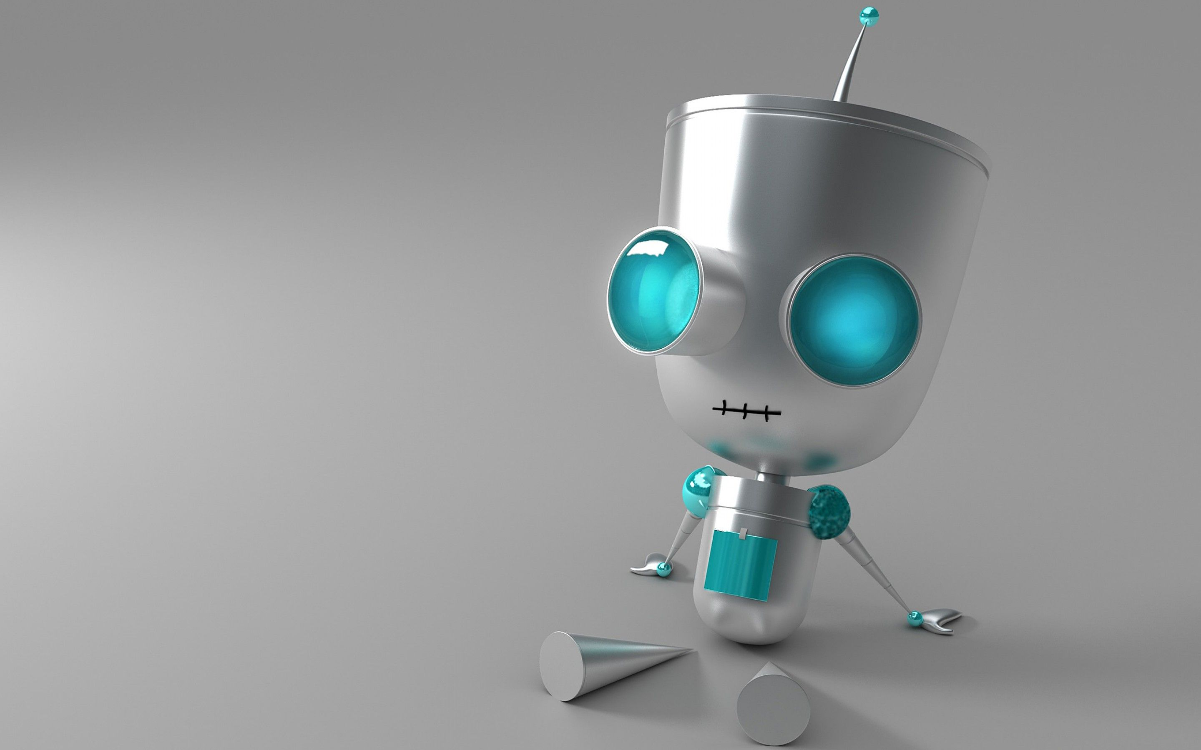
IMPLIMENTATION OF SMART MEDICINE DRAWER
By-Techie-Warlocks
BY-TECHIE-WARLOCKS

Slide 2

CONTENTS:-
1) IMPLIMENTATION
COMPONENTS USED
ARDUINO UNO
REAL TIME CLOCK
PASSIVE ALARM
LCD AND ITS MODULE
PUSH BUTTONS
L298 MODULE
DC MOTOR
CIRCUIT DIAGRAM
CODE IMPLIMENTATION

Slide 3


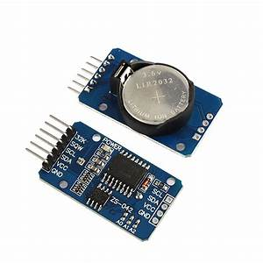
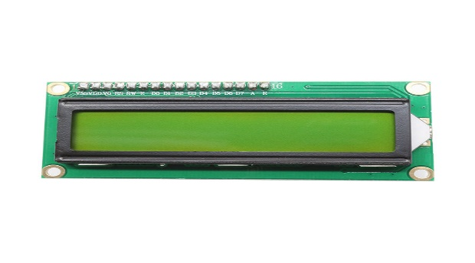
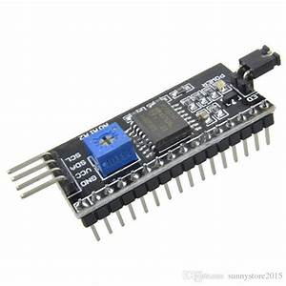
MODULES USED
ARDUINO UNO : The Arduino Uno is an open-source microcontroller board based on the Microchip ATmega328P microcontroller. We have used it for building up our circuit and control all the inputs and outputs.
DS3231 Real Time Clock: The Time Clock Module ( or DS3231 ) is a module that measures the time. In our circuit it is helping us to maintain accurate timekeeping.
Passive Alarm: Passive alarm are automatically activated and emit warning sounds at the time of medication.
The 16×2 LCD display: This LCD is an electronic display module that uses liquid crystal to produce a visible image . In our circuit we are using it to display time.
Resistors: A resistor is a passive two-terminal electrical component that implements electrical resistance as a circuit element.
I2C Module: This module is used to control the LCD display forming the I2C interface.

Slide 4
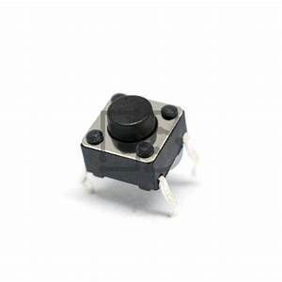
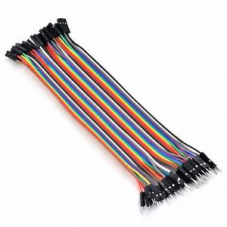
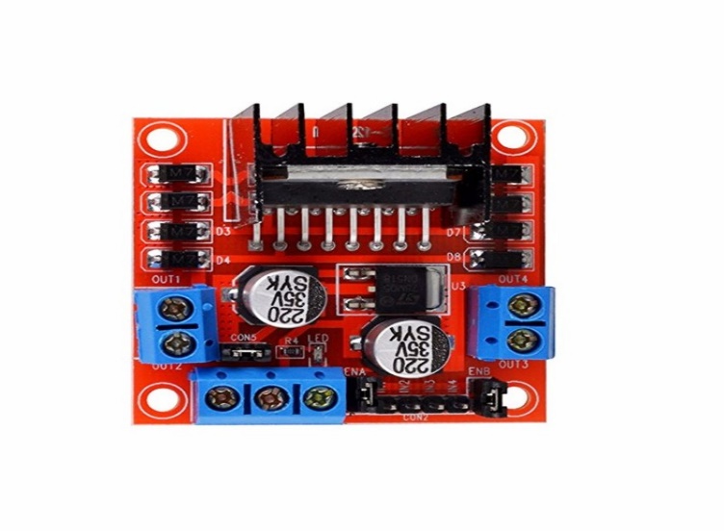
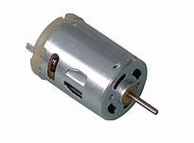
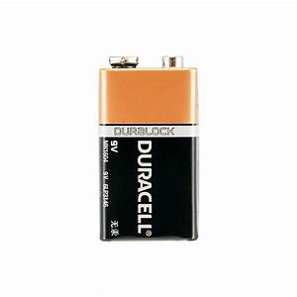
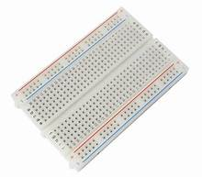
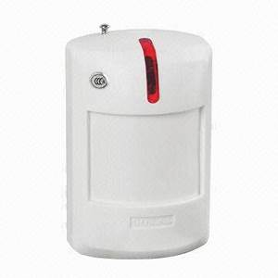
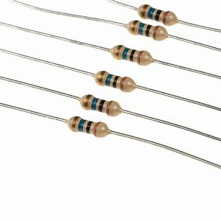

Push Buttons: Push buttons are used in our circuit for setting up the time and entering it.
Jump wires: A jump wire is an electrical wire used to interconnect the components of the circuit.
l298n motor driver:The L298N is a dual-channel H-Bridge motor driver capable of driving two DC motors and one stepper motor. means it can individually drive up to two DC motor for any applications.
DC Motor: A DC motor is any of a class of rotary electrical motors that converts direct current electrical energy into mechanical energy. We are using it for opening and closing of drawer.
Bread Board: A breadboard is a construction base for prototyping of electronics. It helps us to build up circuit without soldering.
9-V Battery: We’ll be using battery in case we do not have any other power source.

Slide 5
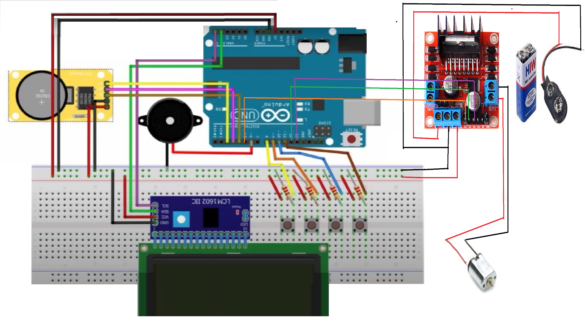

FULL CIRCUIT OF THE MACHINE

Slide 6

Coding of servo motor
1st part explains about the ARDUINO pins, Motors control pins and Function.
2nd part explains how the functions are controlling the spinning direction.
3rd part explains how the speed of motor is going to be controlled and turn off.
int enA = 9;
int in1 = 8;
int in2 = 7;
//more pins
void setup() {
// Set all the motor control pins to outputs
pinMode(enA, OUTPUT);
//more pinMode
}
void loop() {
directionControl();
delay(1000);
speedControl();
delay(1000);
}
// This function lets you control spinning direction of motors
void directionControl() {
// Set motors to maximum speed
analogWrite(enA, 255);
// Turn on motor
digitalWrite(in1, HIGH);
digitalWrite(in2, LOW);
delay(2000);
// Now change motor directions
digitalWrite(in1, LOW);
digitalWrite(in2, HIGH);
delay(2000)
}
void speedControl()
{
for (int i = 0; i < 256; i++) {
analogWrite(enA, i);
delay(20);
}
for (int i = 255; i >= 0; --i) {
analogWrite(enA, i);
delay(20);
}
// Now turn off motors
digitalWrite(in1,in2, LOW);
}

Slide 7

Coding of alarm clock
1st part explains about the ARDUINO pins, Motors control pins and Libraries
2nd part explains about how we can set hours and minutes for alarm
3rd part explains about how to exit from alarm and when it will buzz.
#include <LiquidCrystal_I2C.h>
LiquidCrystal_I2C lcd(0x3F, 16, 2);
#include <DS1302.h>
int pset = 8;
\\more p set commands
void setup()
{pinMode(pset, INPUT);
\\ more input code
void loop()
{lcd.setCursor(0,1);
lcd.print("Hour= ");
lcd.setCursor(9,1);
lcd.print("Min= ");
buttonforhour = digitalRead(phour);
// set hour for alarm
if (buttonforhour == HIGH){
h++;
lcd.setCursor(5,1);
lcd.print(h);
if (h>23){
h=0;
lcd.clear(); }
delay(100); }
buttonformin = digitalRead(pmin); // set minutes for alarm
if (buttonformin == HIGH){
m++;
lcd.setCursor(13,1);
lcd.print(m);
if (m>59){
m=0;
lcd.clear();}
delay(100); }
lcd.setCursor(5,1);
lcd.print(h);
lcd.setCursor(13,1);
lcd.print(m);
buttonforexit = digitalRead(pexit); // exit from set alarm mode
if (buttonforexit == HIGH){
activate = 0;
lcd.clear();}}
if (Hour== h && Min== m) {
tone(6,400,300);}
delay (500);}

Slide 8
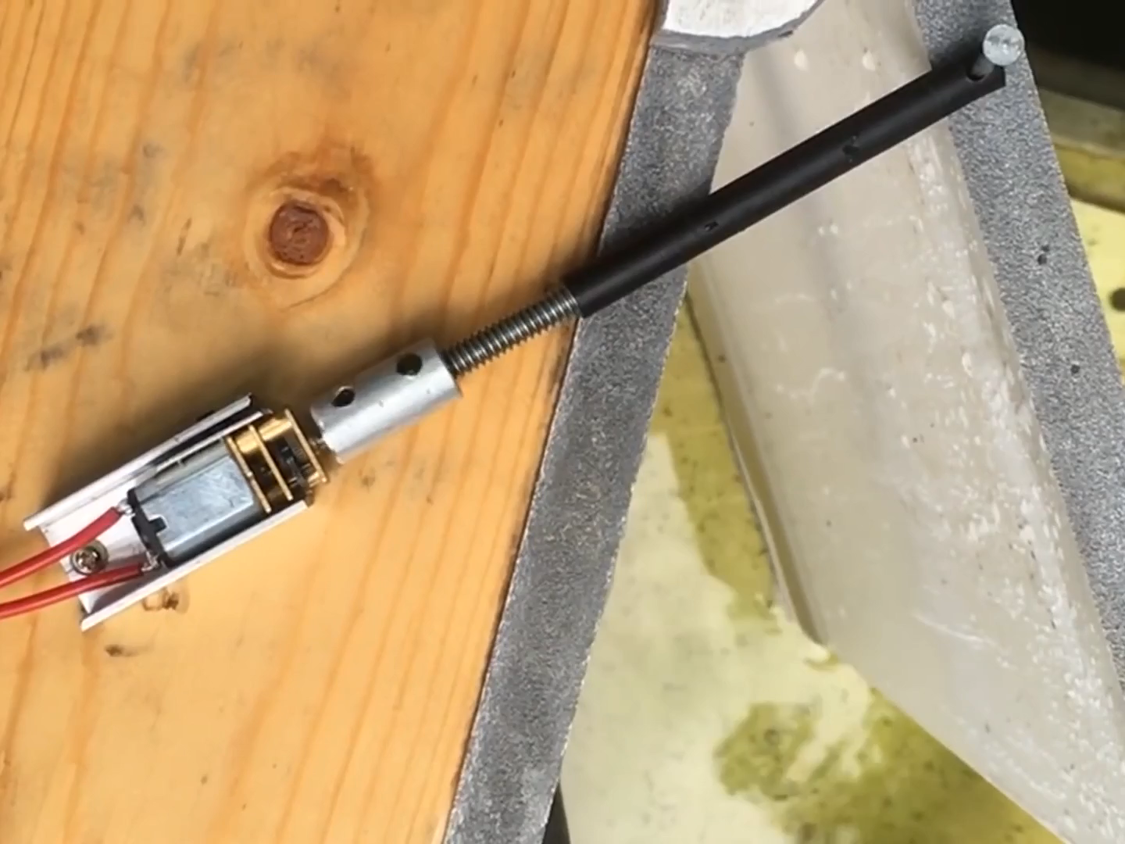

Slide 9


